Slide 1
Assessment of LEarning
Fall 2015

Slide 2
AAT Division reps
Business: Raji Lauffer | Math: Mike Hamm
Library: Lili Kang | COM: Marilyn Cristiano
Fine Arts: Keith Kelly | Science: Jenny Weitz
English: Stacey Ranik | Health: Tatum Voeller
Social Science: Meggin Kirk | Counseling: Jim Rubin
Behavioral Science: Doug Berry

Slide 3
CaT participants
Gary Kellgran | Christine Tabone
Doug Berry | Meggin Kirk
Mike Hamm | Felicia Ramirez

Slide 4
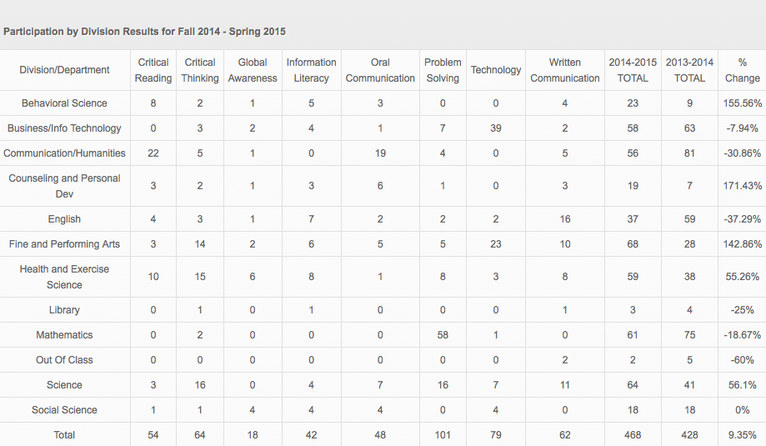

Slide 5
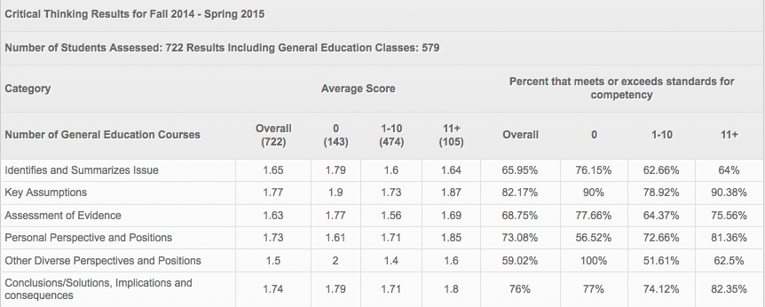
Critical Thinking

Slide 6
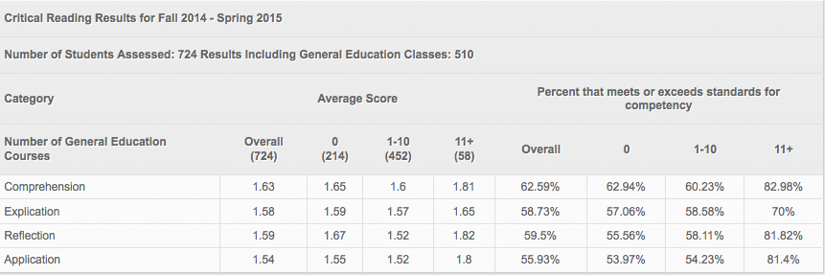
Critical Reading

Slide 7
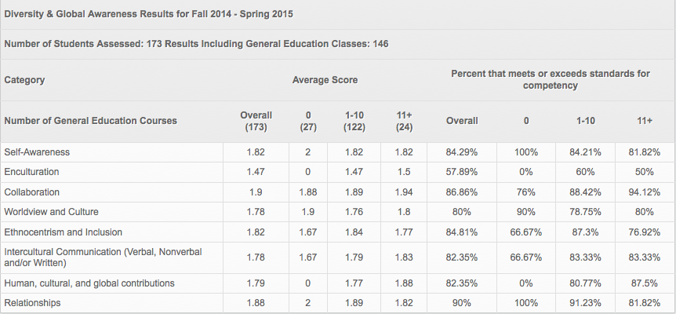
Diversity and global awareness

Slide 8
Information literacy

Slide 9
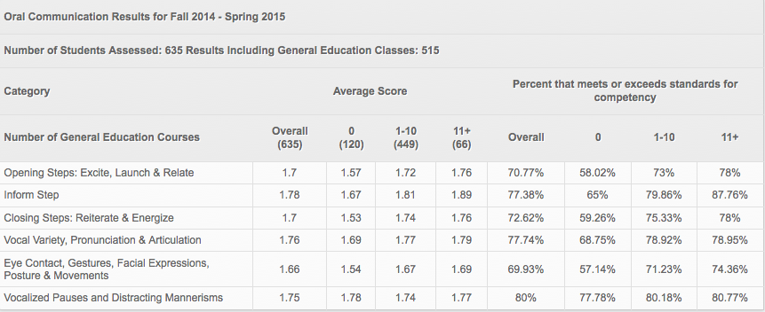
Oral communication

Slide 10
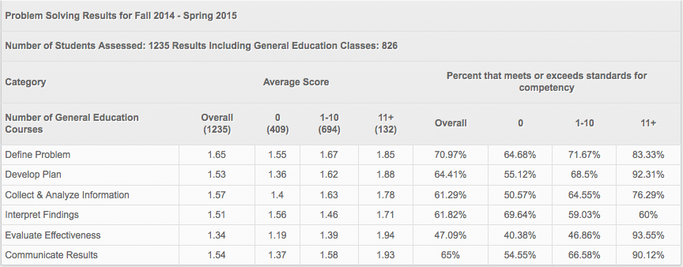
Problem solving

Slide 11
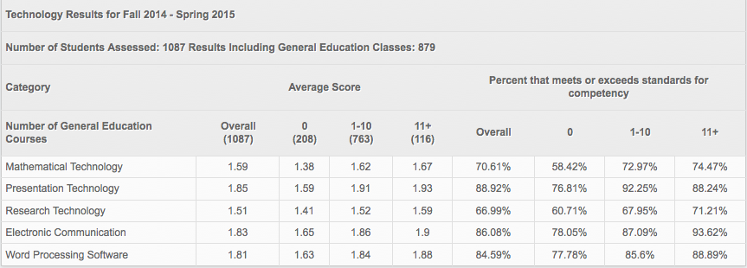
technology

Slide 12
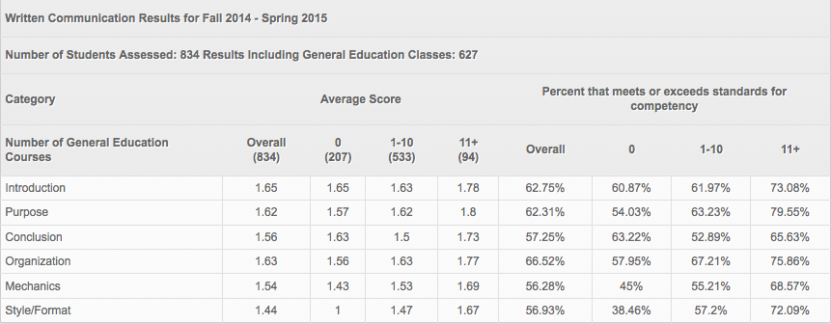
Written communication

